Slide 1

Honolulu Housing Affordability By Occupation
Charles P. Wathen
September 25, 2008

Slide 2

Next Endangered Species?

Slide 3
Overview
The following presentation examines Honolulu’s housing affordability (single-family housing, condominium and rental) by comparing:
  Income
  Shelter Cost
  Occupation Type
  Year (2000, 2003, 2006 and 2008)

Slide 4
Current Situation
77% of homeowners in Honolulu are over the age 0f 52.
The first of the baby boomers are eligible for Social Security and are beginning to retire.
Demand will be created to replace the retiring workers.
Housing prices have risen over 115% while annual income averages have only increased 20-25% over the last 8 years.
What does this mean?

Slide 5
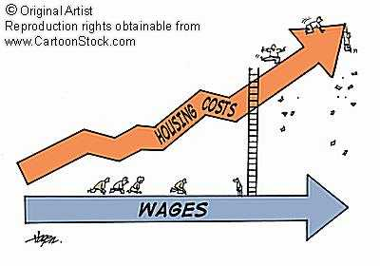
Housing Affordability Crisis

Slide 6
Housing Affordability Crisis
New workers to replace the retiring baby boomers cannot afford to purchase or rent housing in Honolulu.
There are many markets across the country where the new workers can afford to purchase or rent housing.
Rents will continue to increase until they are more in line with the value of homes and condos, further worsening the problem.
There are options, but regulatory barriers are preventing possible solutions.

Slide 7
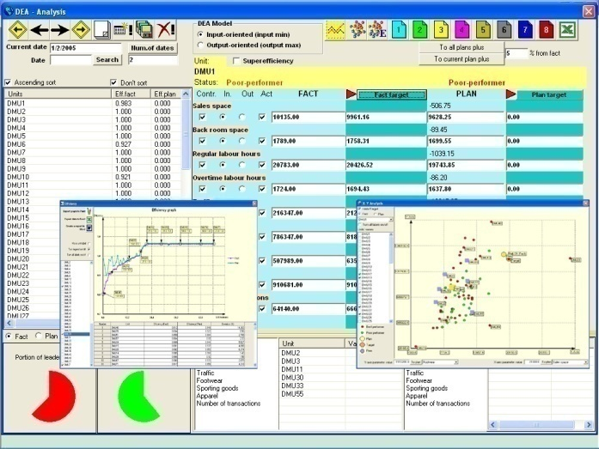
The Analysis

Slide 8
The Analysis
How many job holders by occupation does it take to afford the median house, condo or rental in Honolulu for the years 2000, 2003, 2006 and 2008 by various occupations.
The analysis has been performed for the Honolulu area (data is also available for the combined non-metro markets of Kauai, Maui and Hawaii).
Separate analyses are performed for Single-Family Housing, Condominium and Rental.

Slide 9
The Analysis Cont.
Job categories and salaries are provided by the Bureau of Labor Statistics and include 5 income strata's (over 2,500 possibilities) including 10th percentile, 25th percentile, median, 75th percentile and 90th percentile.
Affordability of the single-family housing, condo or rent is formulated based on liberal underwriting standards (single-family housing and condo) and fair market rents (rents).
Median house price (single-family housing and condo) is provided by Honolulu Board of Realtor’s Statistics.
Fair Market Rents are provided by the Department of Housing and Urban Development (HUD).

Slide 10
Analysis Sample
Occupat ion
Income
Year
Loan
$
Medi an
$
#
Job
Holders

Slide 11

Single-Family Housing Market – 3 Bedroom

Slide 12
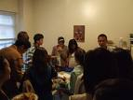
Single-Family Housing Summary
 | Year | 10 PCT | 25 PCT | Median | 75 PCT | 90 PCT | Total | Percent
0-1 | 2000 | 1 | 5 | 8 | 33 | 67 | 114 | 5.04%
1.01 - 2 |  | 34 | 83 | 154 | 206 | 247 | 724 | 32.04%
2.01 - 3 |  | 119 | 129 | 131 | 124 | 97 | 600 | 26.55%
3.01 plus |  | 298 | 235 | 159 | 89 | 41 | 822 | 36.37%
Total |  | 452 | 452 | 452 | 452 | 452 | 2,260 | 100.00%
 |  | 10 PCT | 25 PCT | Median | 75 PCT | 90 PCT | Total | Percent
0-1 | 2003 | 4 | 6 | 7 | 16 | 43 | 76 | 3.63%
1.01 - 2 |  | 16 | 45 | 104 | 165 | 206 | 536 | 25.58%
2.01 - 3 |  | 79 | 111 | 126 | 119 | 107 | 542 | 25.87%
3.01 plus |  | 320 | 257 | 182 | 119 | 63 | 941 | 44.92%
Total |  | 419 | 419 | 419 | 419 | 419 | 2,095 | 100.00%
 |  | 10 PCT | 25 PCT | Median | 75 PCT | 90 PCT | Total | Percent
0-1 | 2006 | - | - | 4 | 7 | 20 | 31 | 1.21%
1.01 - 2 |  | 4 | 7 | 11 | 52 | 113 | 187 | 7.32%
2.01 - 3 |  | 10 | 31 | 105 | 155 | 142 | 443 | 17.34%
3.01 plus |  | 497 | 473 | 391 | 297 | 236 | 1,894 | 74.13%
Total |  | 511 | 511 | 511 | 511 | 511 | 2,555 | 100.00%
2008 |  | 10 PCT | 25 PCT | Median | 75 PCT | 90 PCT | Total | Percent
0-1 | 2008 | - | - | 4 | 7 | 20 | 31 | 1.21%
1.01 - 2 |  | 4 | 9 | 19 | 72 | 134 | 238 | 9.32%
2.01 - 3 |  | 14 | 52 | 139 | 159 | 147 | 511 | 20.00%
3.01 plus |  | 493 | 450 | 349 | 273 | 210 | 1,775 | 69.47%
Total |  | 511 | 511 | 511 | 511 | 511 | 2,555 | 100.00%
 |  | Total All | 2000 | 2003 | 2006 | 2008 | Total | Percent
0-1 | Total All |  | 114 | 76 | 31 | 31 | 252 | 2.66%
1.01 - 2 |  |  | 724 | 536 | 187 | 238 | 1,685 | 17.80%
2.01 - 3 |  |  | 600 | 542 | 443 | 511 | 2,096 | 22.14%
3.01 plus |  |  | 822 | 941 | 1,894 | 1,775 | 5,432 | 57.39%
Total |  |  | 2,260 | 2,095 | 2,555 | 2,555 | 9,465 | 100.00%
2008

Slide 13
Single-Family Housing Affordability By Occupants
* - Based on all by job possibilities.

Slide 14
Single-Family Housing Conclusion
In 2000, 5% of all job possibilities could afford the median house with one income.
  In 2008, this has decreased to 1% of all job possibilities which equates to a 80% decrease.
In 2000, over 36% of all job possibilities required over 3 job holders to afford the median house.
  In 2008, this has skyrocketed to over 69%.
Almost 90% of all dual income marries couples still cannot afford the median house price in Honolulu.

Slide 15
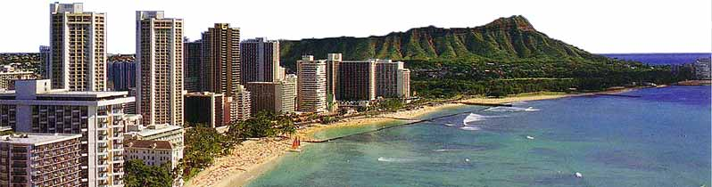
Condominium Market – 1.75 Bedroom

Slide 16
Condominium Summary
 | Year | 10 PCT | 25 PCT | Median | 75 PCT | 90 PCT | Total | Percent
0-1 | 2000 | 79 | 135 | 210 | 286 | 358 | 1,068 | 47.26%
1.01 - 2 |  | 219 | 221 | 198 | 154 | 92 | 884 | 39.12%
2.01 - 3 |  | 151 | 96 | 44 | 12 | 2 | 305 | 13.50%
3.01 plus |  | 3 | - | - | - | - | 3 | 0.13%
Total |  | 452 | 452 | 452 | 452 | 452 | 2,260 | 100.00%
 |  | 10 PCT | 25 PCT | Median | 75 PCT | 90 PCT | Total | Percent
0-1 | 2003 | 23 | 54 | 117 | 187 | 253 | 634 | 30.26%
1.01 - 2 |  | 170 | 203 | 203 | 190 | 153 | 919 | 43.87%
2.01 - 3 |  | 122 | 115 | 90 | 41 | 13 | 381 | 18.19%
3.01 plus |  | 104 | 47 | 9 | 1 | - | 161 | 7.68%
Total |  | 419 | 419 | 419 | 419 | 419 | 2,095 | 100.00%
 |  | 10 PCT | 25 PCT | Median | 75 PCT | 90 PCT | Total | Percent
0-1 | 2006 | 4 | 7 | 15 | 59 | 133 | 218 | 8.53%
1.01 - 2 |  | 54 | 132 | 211 | 256 | 248 | 901 | 35.26%
2.01 - 3 |  | 150 | 149 | 145 | 118 | 101 | 663 | 25.95%
3.01 plus |  | 303 | 223 | 140 | 78 | 29 | 773 | 30.25%
Total |  | 511 | 511 | 511 | 511 | 511 | 2,555 | 100.00%
 |  | 10 PCT | 25 PCT | Median | 75 PCT | 90 PCT | Total | Percent
0-1 | 2008 | 4 | 8 | 22 | 76 | 144 | 254 | 9.94%
1.01 - 2 |  | 70 | 147 | 223 | 252 | 247 | 939 | 36.75%
2.01 - 3 |  | 151 | 152 | 135 | 123 | 94 | 655 | 25.64%
3.01 plus |  | 286 | 204 | 131 | 60 | 26 | 707 | 27.67%
Total |  | 511 | 511 | 511 | 511 | 511 | 2,555 | 100.00%
 |  | Total All | 2000 | 2003 | 2006 | 2008 | Total | Percent
0-1 | Total All |  | 1,068 | 634 | 218 | 254 | 2,174 | 22.97%
1.01 - 2 |  |  | 884 | 919 | 901 | 939 | 3,643 | 38.49%
2.01 - 3 |  |  | 305 | 381 | 663 | 655 | 2,004 | 21.17%
3.01 plus |  |  | 3 | 161 | 773 | 707 | 1,644 | 17.37%
Total |  |  | 2,260 | 2,095 | 2,555 | 2,555 | 9,465 | 100.00%
2008

Slide 17
Condominium Affordability By Occupants
* - Based on all job possibilities.

Slide 18
Condominium Conclusion
In 2000, over 47% of all job possibilities could afford the median condo with one income.
  In 2008, this has decreased to 10% of all job possibilities which equates to over a 79% decrease.
In 2000, there were less than 1% of job possibilities that required over 3 job holders to afford the median house.
  In 2008, this has jumped to over 27%.

Slide 19
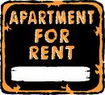
Rental Market –
3 Bedroom

Slide 20
Rental Summary
 | Year | 10 PCT | 25 PCT | Median | 75 PCT | 90 PCT | Total | Percent
0-1 | 2000 | 39 | 92 | 167 | 246 | 317 | 861 | 38.10%
1.01 - 2 |  | 208 | 223 | 216 | 184 | 128 | 959 | 42.43%
2.01 - 3 |  | 137 | 117 | 65 | 22 | 7 | 348 | 15.40%
3.01 plus |  | 68 | 20 | 4 | - | - | 92 | 4.07%
Total |  | 452 | 452 | 452 | 452 | 452 | 2,260 | 100.00%
 |  | 10 PCT | 25 PCT | Median | 75 PCT | 90 PCT | Total | Percent
0-1 | 2003 | 53 | 109 | 181 | 256 | 309 | 908 | 43.34%
1.01 - 2 |  | 206 | 206 | 193 | 151 | 107 | 863 | 41.19%
2.01 - 3 |  | 160 | 104 | 45 | 12 | 3 | 324 | 15.47%
3.01 plus |  | - | - | - | - | - | - | 0.00%
Total |  | 419 | 419 | 419 | 419 | 419 | 2,095 | 100.00%
 |  | 10 PCT | 25 PCT | Median | 75 PCT | 90 PCT | Total | Percent
0-1 | 2006 | 12 | 33 | 108 | 207 | 271 | 631 | 24.70%
1.01 - 2 |  | 191 | 247 | 260 | 220 | 208 | 1,126 | 44.07%
2.01 - 3 |  | 143 | 128 | 101 | 73 | 30 | 475 | 18.59%
3.01 plus |  | 165 | 103 | 42 | 11 | 2 | 323 | 12.64%
Total |  | 511 | 511 | 511 | 511 | 511 | 2,555 | 100.00%
 |  | 10 PCT | 25 PCT | Median | 75 PCT | 90 PCT | Total | Percent
0-1 | 2008 | 6 | 11 | 38 | 102 | 175 | 332 | 12.99%
1.01 - 2 |  | 99 | 178 | 247 | 258 | 238 | 1,020 | 39.92%
2.01 - 3 |  | 158 | 151 | 116 | 112 | 87 | 624 | 24.42%
3.01 plus |  | 248 | 171 | 110 | 39 | 11 | 579 | 22.66%
Total |  | 511 | 511 | 511 | 511 | 511 | 2,555 | 100.00%
 |  | Total All | 2000 | 2003 | 2006 | 2008 | Total | Percent
0-1 | Total All |  | 861 | 908 | 631 | 332 | 2,732 | 28.86%
1.01 - 2 |  |  | 959 | 863 | 1,126 | 1,020 | 3,968 | 41.92%
2.01 - 3 |  |  | 348 | 324 | 475 | 624 | 1,771 | 18.71%
3.01 plus |  |  | 92 | - | 323 | 579 | 994 | 10.50%
Total |  |  | 2,260 | 2,095 | 2,555 | 2,555 | 9,465 | 100.00%
2008

Slide 21
Rental Affordability By Occupants
* - Based on all job possibilities.

Slide 22
Rental Conclusion
Rentals fared much better which reinforced the theory that rents will continue to increase.
In 2008, over 39% of the job possibilities can afford a rental with 2 jobholders.
In 2008, 22% of the job possibilities require 3 or more jobholders to afford the median 3-bedroom rent (fair market rent).

Slide 23
Analysis Summary - 2008

Slide 24
Analysis Summary - 2008
 |  | 10 PCT | 25 PCT | Median | 75 PCT | 90 PCT | Total | Percent
House | 0-1 | 0 | 0 | 4 | 7 | 20 | 31 | 1.21%
 | 1.01 - 2 | 4 | 9 | 19 | 72 | 134 | 238 | 9.32%
 | 2.01 - 3 | 14 | 52 | 139 | 159 | 147 | 511 | 20.00%
 | 3.01 plus | 493 | 450 | 349 | 273 | 210 | 1775 | 69.47%
 | Total | 511 | 511 | 511 | 511 | 511 | 2555 | 100.00%
Condo | 0-1 | 4 | 8 | 22 | 76 | 144 | 254 | 9.94%
 | 1.01 - 2 | 70 | 147 | 223 | 252 | 247 | 939 | 36.75%
 | 2.01 - 3 | 151 | 152 | 135 | 123 | 94 | 655 | 25.64%
 | 3.01 plus | 286 | 204 | 131 | 60 | 26 | 707 | 27.67%
 | Total | 511 | 511 | 511 | 511 | 511 | 2555 | 100.00%
Rent | 0-1 | 6 | 11 | 38 | 102 | 175 | 332 | 12.99%
 | 1.01 - 2 | 99 | 178 | 247 | 258 | 238 | 1020 | 39.92%
 | 2.01 - 3 | 158 | 151 | 116 | 112 | 87 | 624 | 24.42%
 | 3.01 plus | 248 | 171 | 110 | 39 | 11 | 579 | 22.66%
 | Total | 511 | 511 | 511 | 511 | 511 | 2555 | 100.00%

Slide 25
Are College Graduates Staying in Hawaii?
“At my salary level (in Hawaii), I was unable to move out of my parents’ home. I couldn’t afford much. I moved… and immediately had a job offer.”
Andrea Thomas
(Former Hawaii resident)
“I thought I would never leave Hawaii. Even when I went to Utah State, it was to get a degree, then to come back home.”
The Kamehamema Schools graduate experienced a long and frustrating job search in Hawaii before turning his attention to the mainland; he is now a teacher in Utah.
Source: Star Bulletin

Slide 26

Where Else Can A Worker Afford To Live?
Police and Sheriff’s Patrol Officers

Slide 27

Where Else Can A Worker Afford To Live?
Physical Therapists

Slide 28

Where Else Can A Worker Afford To Live?
Elementary School Teachers

Slide 29

What Does This All Mean?
In 2003, the median salary was $29,350 for all occupations and it took 3.34 workers to afford the median home.
In 2008, the median salary is $33,782 and it takes 5.14 workers to afford the median home.
To match the home purchasing power from 2003, the average employee would require a:
54% Raise!
($16.24/hour $25.01/hour)

Slide 30

What Does This All Mean?
“Hawaii and Honolulu are suffering from a supply imbalance. When employment increases and the economy starts growing, it takes too long and it is far too difficult because of the regulatory barriers for the housing industry to deliver adequate units quickly enough and efficiently enough to temper the price spiral.”
Paul Brewbaker
Senior Vice President and Chief Economist
Bank of Hawaii

Slide 31

What Does This All Mean?

Slide 32
What Does This All Mean?
Honolulu and Hawaii are the most regulated places in America.
Without a supply release mechanism, all housing costs will increase.
Honolulu will face continuous spiraling price pressure with home prices (and all shelter costs).
When people can no longer double up and their quality of life declines, Honolulu’s economy will go into a dislocation period or wages will have to increase rapidly to make up for the imbalance.

Slide 33
What Is The Solution?
Comprehensive approach must be taken to reform regulatory barriers and streamline the permitting process.
Other impediments need to be addressed including infrastructure, tax abatement and subsidy.
But how do we do this?

Slide 34
The Solution
Broad based coalition that can advocate and educate the public and elected officials as to the solutions.
Gain the support of business and industry leaders along with as many housing advocates and providers.
Strength is in the number of members that can be added and the quality of the business and leaders that support this common mission.

Slide 35
Conclusion
Honolulu is in a state of crisis!
Baby Boomers are retiring and their skills will be difficult to replace.
Educated new workers will choose more affordable markets to begin their careers.
Qualified workers will seek employment elsewhere or Honolulu Businesses’ will have to significantly raise wages.

Slide 36
Honolulu Housing Affordability By Occupation
Charles P. Wathen
April 25, 2008

